Slide 1
Project Management Review
for
Customer Profile
Review Date : 28-Oct-05
Reporting Period : October
Point of execution : Offshore
Locus of Management Control :
Speaker name : Shan Ying
Title, HP - GDCC : Project Lead

Slide 2
Agenda
Project Profile
Project Organization Chart.
Project’s Business Attributes
PMR’s Action Items Review
Project Status Summary
Project Metrics
Customer Escalations & Commendations
Risk Management
Issues & Dependency Management
Project Health on Quality
Configuration Mgt. and Disaster Mgt.
Process Improvement
DP/CAR
Work/Life Balance
Tools Usage
KM Update
Skill Identification and Training plan
Project End Metrics

Slide 3
Project Profile
Project Name | ECO IT eBusiness Financial Gateway
Project Code / Id | SEFG1001
Delivery Unit
Location | Shanghai
Project Mgr.’s Name | Xu, Jin-Shui
Customer Org. Name | GOIT ECO-IT eBusiness IT
Customer’s Geography | USA
Customer Contact Info Name of contact in Cust. Org Phone No. of Cust. Contact Email Id of Cust. Contact | Andrews, Greg +1 281 514 9492 Greg.Andrews@hp.com
Project Billing Type
Life Cycle Model | V
Domain | O&C
Development Language | .Net, J2EE
Peak Team Size (initial) | 5
Technology | Web based App

Slide 4
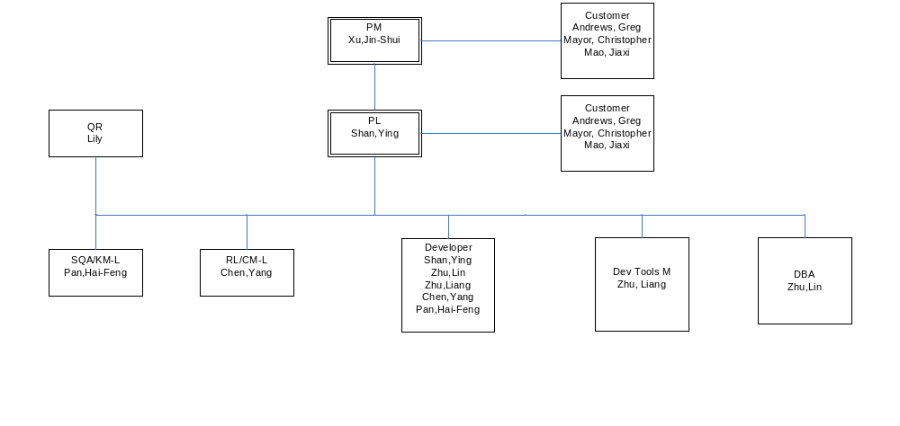
Project Organization Chart

Slide 5
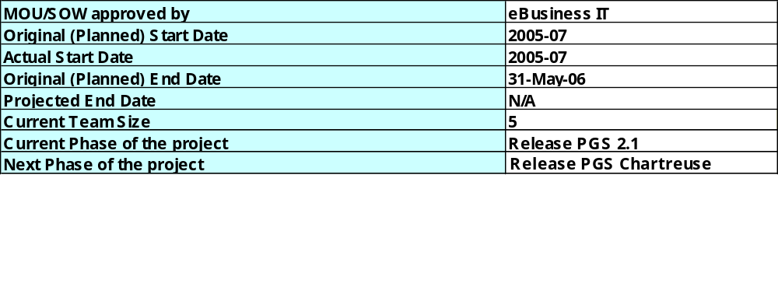
Project’s Business Attributes

Slide 6
Project’s Business Attributes…
Estimation methodology used | customized estimation sheet
Original Business Function Count / Work Packages / FP
Projected Business Function Count / Work Packages / FP
Original (Estimated) Total Effort (release based)
Total Effort expended to-date (release based)
Projected Total Effort at completion (release based)
# of Change Requests implemented
# of Approved Change Requests
Effort/cost impact due to change request/s
Schedule impact due to change request/s
# of Paid-for Changes
Last Customer Satisfaction Survey Rating
Project specific attributes

Slide 7
PMR Action Items Review
Actions items status from earlier PMR’s
No. | Action Item | Owner | Planned Closure Date | Actual Closure Date | Remarks

Slide 8
Project Status Summary
< Sections below can be replaced by links to appropriate project specific tools/worksheets >
Key Accomplishments in this Reporting Period Knowledge transfer done
Setbacks if any in this Reporting Period N/A
Key Activities planned for next Reporting Period Release PGS Chartreuse sign off

Slide 9
Project Metrics Dashboard
Not Available Now

Slide 10
Project Metrics
Not Available Now

Slide 11
Metrics Analysis
Not Available Now

Slide 12
Defect Containment
Not Available Now

Slide 13

Earned Value Analysis

Slide 14
Customer Escalations till date
Customer Escalations & Commendations
< Table below can be replaced by a link to “Customer Issues Tracker worksheet” in customer_issues_tracker_ tem.xls >
No. | Escalation Details | Escalation Level (PM / Senior Mgt.) | Root Cause | Action Taken or To Be Taken | Owner | Planned Closure Date | Actual Closure Date
 | N/A
Customer Commendations till date
No. | Commendation Details | Date
 | N/A

Slide 15

Risk Management

Slide 16
Issues & Dependency Management
Issue Management
Dependency Management

Slide 17
Project health on “Quality” front
Quality Reps Project Health report findings
No. | Areas in Red and Yellow | Actions taken or to be taken to address areas highlighted. | Owner | Planned Closure Date | Actual Closure Date
 | N/A
Project SQA Audit findings
No. | NC’s / Improvement Areas (Areas in Red and Yellow) | Actions taken or to be taken to address Project SQA findings. | Owner | Planned Closure Date | Actual Closure Date
 | N/A
Org. / External Audit findings
# of NC’s raised | # of NC’s Closed | Reasons for pending (Only for ‘open’ NC’s) | Owner | Planned Closure Date | Actual Closure Date
 | N/A

Slide 18
Configuration Management
Date of last CM Audit :
CM Audit conducted by :
CM Audit findings
No. | NC’s / Improvement Areas | Actions taken or to be taken to address CM Audit findings. | Owner | Planned Closure Date | Actual Closure Date
 | N/A
Disaster Management
Frequency of Back up (Daily / Weekly) : Daily
Confirmed by IT (Yes/No) : Yes
Verified by PM (Yes/No) : Yes
Location of backed up tapes : stored in Bank
(Confirm from IT and mention the location)

Slide 19
Process Improvement
Process Improvement Initiatives in the project
# of PIFs raised by the project team | 0
# of best practices submitted to the org history database | 0 (not reach retro meeting)
# of artifacts reviewed by members of Practitioners Review Board (PRB) from within the project team | 0
# of project team members working on Process Improvement Projects (PIP) | 0

Slide 20
Causal Analysis & Resolution
Defect Prevention (DP)
Sl No. | Potential Defect or Issue identified | Date | Preventive Actions planned | Target Completion Date (mm/dd/yy) | Preventive Actions Implemented | Status (Open/Closed/ In progress /Abandoned) | Remarks
 | N/A
DP & CAR
Please refer the document on CVS: \FGW\30PM\30.30Planning\GDCC_eBusiness Financial Gateway_Defect Prevention Plan.xls

Slide 21
Tools Usage
Tools usage:
Engineering
Phase | Tools planned | Tools Used
Requirements Analysis | Word, Excel | Word, Excel
Design | Rose, Word | Rose, Word
Construct (Coding & testing) | JBuilder, Eclipse Visual Studio .Net 2003, Weblogic Workshop | JBuilder, Eclipse, MyEclipse, Biztalk Visual Studio .Net 2003, Weblogic Workshop
Testing | Quick Test, Load Runner, ITS | JUnit, NUnit
Release | Word, jar, exe,
Support & Process Automation
Process | Tools planned | Tools Used
Configuration Management | CVS client | CVS client
Project Management | MS Project | MS project
Process Automation | ITS

Slide 22
KM Update
http://gdcckm.chn.hp.com/teams/itmb/pp/hpit/EIEFG/default.aspx
Reused artifacts / components (Phase-wise)
N/A
Submissions to the Knowledge Briefs
N/A
Artifacts submitted by the project to the various KM repositories
N/A
Patent Disclosures, Patents Filed
N/A
Postings in the HPS Forums

Slide 23
Work Life Balance
Average team hours per day: _8_ Hrs
% of team working on Saturday: _0_ %
% of team working on Sunday: _0_ %
% of team working on public holidays: _0_ %
Last celebration / team event on: __July 2005
Team Motivation and Morale Issues (if any)

Slide 24
Skill Identification and Training Plan
Skill Set Identification & Training Plan
Please refer the document on CVS: \FGW\40Support\40.20Training\GDCC_SEFG1001_PGS_Training_Plan.xls

Slide 25
Project End Metrics
Not applicable

Slide 26

Thank You

